Slide 1
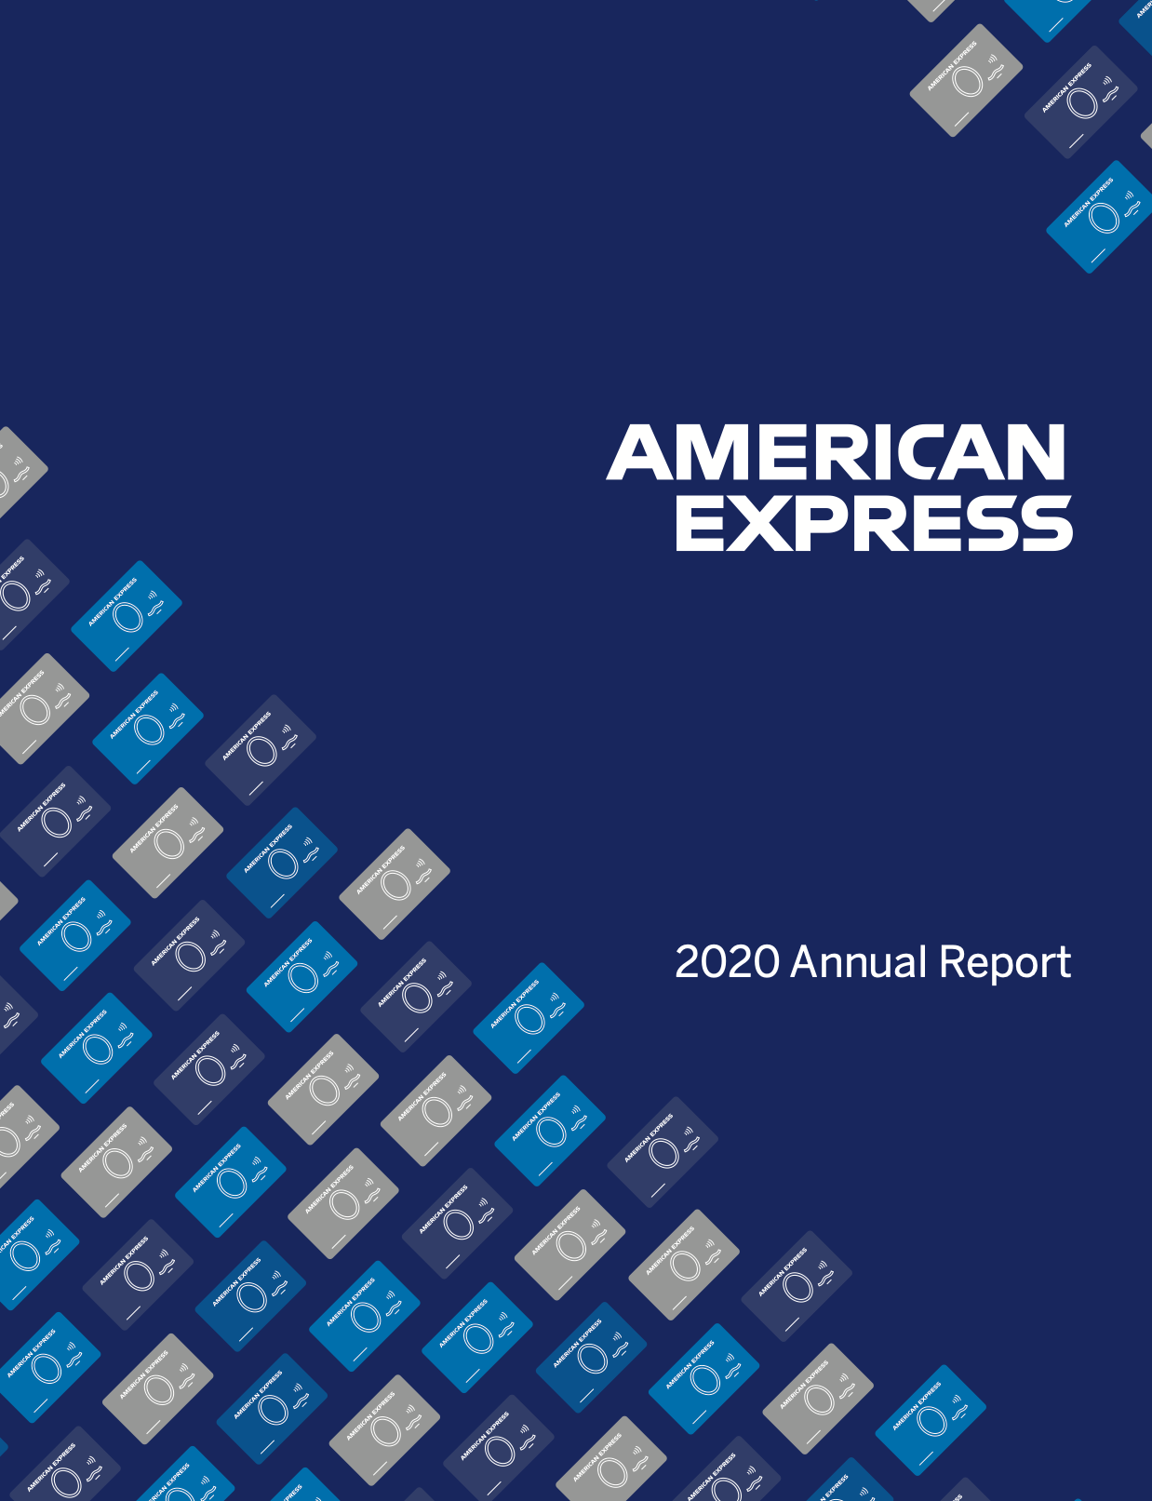
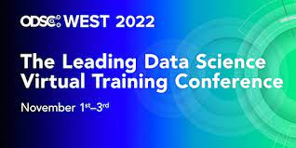
Data Drift Identification for AI Models in the context of AI Governance
Operationalizing AI Models with Governance
Sourav Mazumder
Master Inventor
AI/ML Operationalization Leader
The Open Group Distinguished Data Scientist
IBM Expert Labs
https://www.linkedin.com/in/souravmazumder @souravmazumder0
November 03, 2022

Slide 2
Agenda
1. Introduction (10 min)
Instructor Introduction
Setup
2. Concepts (20 min)
Introduction to AI governance
AI Governance flow & Architecture
Introduction to Data Drift for NLP Models
Challenges and typical solution approach for Data Drift for NLP Model
3. Hands On work (60 min)
Use Case Introduction
Mapping Hands on Work to AI Governance flow for Data Drift monitoring
Lab 1 – Training Data Statistics Generation for Data Drift
Lab 2 – Drift Computation using Scoring Data
Lab 3* – Using Drift Computation in AI Governance Flow
Q and A
CP4D : Cloud Pak for Data

Slide 3
Agenda
1. Introduction (10 min)
Instructor Introduction
Setup
2. Concepts (20 min)
Introduction to AI governance
AI Governance flow & Architecture
Introduction to Data Drift for NLP Models
Challenges and typical solution approach for Data Drift for NLP Model
3. Hands On work (60 min)
Use Case Introduction
Mapping Hands on Work to AI Governance flow for Data Drift monitoring
Lab 1 – Training Data Statistics Generation for Data Drift
Lab 2 – Drift Computation using Scoring Data
Lab 3* – Using Drift Computation in AI Governance Flow
Q and A
CP4D : Cloud Pak for Data

Slide 4
Setup
Using you any personal email account create a new (free) account in IBM Cloud using thi url https://www.ibm.com/cloud?utm_content=SRCWW&p1=Search&p4=43700068021082968&p5=p&gc[…]LmZQsxzcZlwcp4e19df5uG_r5w_cCBG5k0YyxoCMQUQAvD_BwE&gclsrc=aw.ds
After creating the account use the same to create a new IBM Cloud Pak for Data service in IBM Cloud by clicking the ‘Try it for Free’ in this url - https://www.ibm.com/products/cloud-pak-for-data?utm_content=SRCWW&p1=Search&p4=437[…]7W4ZZPi9cqM9wtua8FZeVAZDqZdb8D_OCF4lBoCvXoQAvD_BwE&gclsrc=aw.ds
Access github repoitory - https://github.com/sourav-mazumder/NLP-Drift. Go to folder JupyterNotebooksForIBMWatsonStudio and download NLP-Drift-Project.zip
After the IBM Cloud Pak for Data service is provisioned - Go to the left navigation menu bar, Click on Projects, Click on New Project, Click on Project From File. In the next screen select ‘From File’ and upload the zip file provided.
If you want to use your computer/laptop access the Notebooks from JupyterNotebooksForLocalEnv folder and dataset from the Data folder of the repository.
CP4D : Cloud Pak for Data

Slide 5
Agenda
1. Introduction (10 min)
Instructor Introduction
Setup
2. Concepts (20 min)
Introduction to AI governance
AI Governance flow & Architecture
Introduction to Data Drift for NLP Models
Challenges and typical solution approach for Data Drift for NLP Model
3. Hands On work (60 min)
Use Case Introduction
Mapping Hands on Work to AI Governance flow for Data Drift monitoring
Lab 1 – Training Data Statistics Generation for Data Drift
Lab 2 – Drift Computation using Scoring Data
Lab 3* – Using Drift Computation in AI Governance Flow
Q and A
CP4D : Cloud Pak for Data

Slide 6
Trustworthy AI Solutions and AI Governance
AI Solutions are mostly created using Machine Learning/Deep Learning/Statistical models (AI Models) which are non-deterministic in nature and cannot be trusted for business use as is.
Enterprises need to ensure that the AI Solutions are Trustworthy because of the following business reasons
Positive Business Outcome
To avoid negative impact on business or end customer’s interest
Regulatory Compliance
To align with Government Guidelines and directives in using AI for business
Social Responsibility
To protect Brand Image against any ethical dispute
AI Governance is a mechanism to put Guard Rails around the development and productization process of AI Models to ensure the Trustworthiness of AI Models
CP4D : Cloud Pak for Data

Slide 7
Enterprises must consider regulatory compliance and standards related to AI as they scale AI throughout their business
UK
2022 – Policy on Pro-innovation approach to regulating AI
2022 - AI standards from British Standards Institutions
Canada
2017—National AI Strategy launched
2020—All public agencies must do an impact analysis for AI models
European Union
2022 - European Commission standardizing requirements of the Artificial Intelligence Act
2019—Guidelines for AI development
USA
2021 – FTC Guidance on AI
2019— Algorithmic Accountability Act
2011 - SR 11–07 requires model risk management for all models in financial services
Mexico
2018—General principles for AI development in the government
Finland
2018—Report on policy recommendations for reskilling workers
2

Slide 8
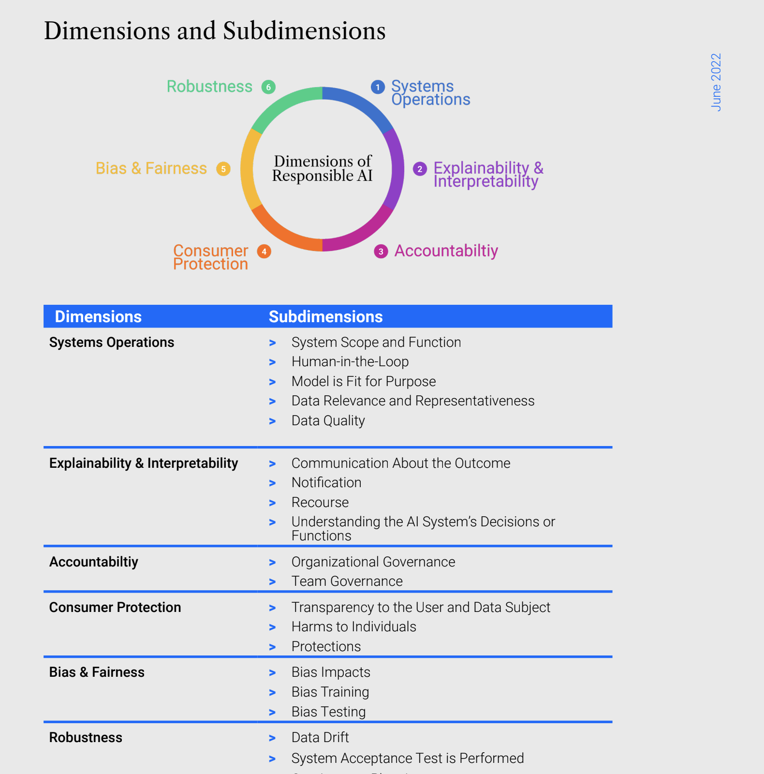
…. and the emerging AI Certification Standards like standards from Responsible AI Institute (RAII)
IBM’s Cloud Pak for Data platform can be used to comply with AI certification standards from RAII

Slide 9
Key characteristics of AI Governance frameworks
AI Governance frameworks can help enterprises create Trustworthy AI solutions with Scalable ML Operationalization
1. For AI Models developed and deployed in multiple technologies
2. For any kind of AI Model – Models with Structured Data, NLP, OCR, Deep Learning, Multi Target Models, etc
3. For large volumes of Models
4. For productionization of Models within a short timeframe
CP4D : Cloud Pak for Data

Slide 10
AI Governance solution in a typical customer context
AI Governance Functions
LOB 1
LOB 2
LOB 3
LOB 4
LOB 5
AI Governance Control
(Governance Workflow, Policies, Gates)
AI Governance Solution
Data Governance
(Protection, Enhanced Meta Data, Data-Model Lineage)
AI Governance Solution
Build
(Data, Code, Binary)
In House, Technology 1
In House, Technology 2
In House, Technology 3
In House, Technology 4
In House, Technology 5
Deploy
In House, Technology 1
In House, Technology 2
In House, Technology 3
In House, Technology 4
In House, Technology 5
Monitor
AI Governance Solution
Explain
AI Governance Solution
Centralized Facts
(Candidacy, Experiments, Validation, Human Interventions)
AI Governance Solution

Slide 11
Reference Architecture of AI Governance mapped to key services
Model Lifecycle Workflow
Workflow with Governance for Risk and Compliance
Model Facts Management
All Details about a Model across its lifecycle phases
Lifecycle Automation
CI/CD
Model Development
Model Independent Validation
Model Deployment & Scoring
Model Monitoring
Feature Engineering, Model Development & Training Data Statistics Computation for Drift, Bias, Explanation
Bias, Drift, Interpretability, Quality, Custom Metrics
Online, Batch
Bias, Drift, Interpretability, Quality, Custom Metrics
Training Data
Validation Dataset
Scoring Input
Training Data Statistics,
Ground Truth, Scoring Payload
Feature Store
Scoring Data
Training Data
Search for
Data, Features, Models
Access Control
Data Protection
Version Management
Ground Truth Data
Validation Data
Business Term Association
Data Quality
Data Fabric
Data/Model Lineage
Data/Model Catalogs
Explanation Data
Training Data Statistics
Metrics
Data Acquisition
Data Source Connections, Connected Data Assets, Virtualized Data Assets

Slide 12
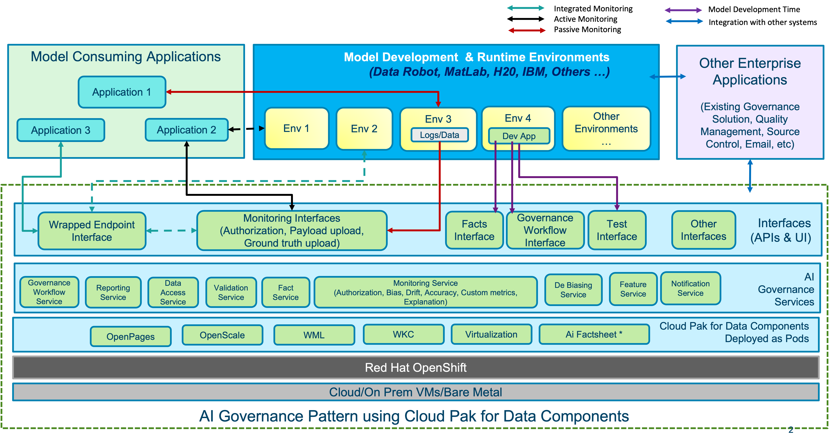
AI Governance Platform in enterprise context – Reference Architecture for Integration
Integration with existing technologies
Flexibility and options for different kind of Models and practices at the various LOB level
Adherence to the security standards
The possible Hybrid solution between On-premise and cloud
AI Governance Platform

Slide 13





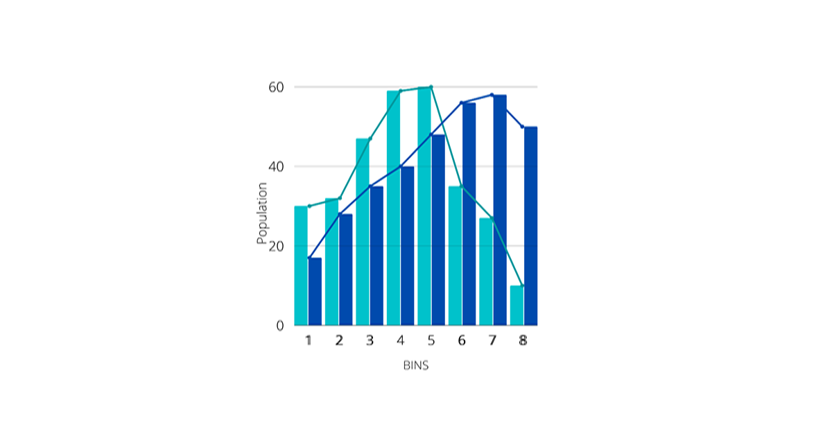
Typical Metrics for AI Models covered in AI Governance framework
The 6 Pillars of a Healthy Machine Learning Model
Performance
Confidence
Fairness
Robustness
Explainability
Drift
Does the model continue to recommend the right decisions in production?
Is the model certain about the decisions it recommends?
Are the decisions recommended by the model fair across all subgroups?
Can the model be protected from adversarial attacks?
Can the model’s outcomes be interpreted by the end user?
Are the Features of the scoring data drifting from the Training data ?
https://ibm.biz/AI-HealthCheck
Feature and Prediction Drift

Slide 14
What is data Drift in NLP model ?
NLP models suffer from data drift like any other machine learning model.
Data drift occurs when the data used to train a model no longer represents the data that is received in scoring data in production.
In NLP models Data Drift can happen because of following common reasons -
Not trained with enough examples with different synonyms of words
Learning happened with data representing different context
Learning was for different concept
CP4D : Cloud Pak for Data

Slide 15
What is data Drift in NLP model – Example study
Consider an NLP model that needs to predict whether a sentence contains information related to where a person works.
Training Data
“I work for IBM”, ‘Y’
“I have to get a job at Microsoft”, ‘N’
“I do not work for IBM”, ‘Y’
“The customer is a contractor in IBM”, ‘Y’
“I am going to my work”, ‘N’
Scoring Data (with Model’s prediction, ground Truth, and possible Drift)
“I do not work for Google”, ‘Y’, ‘Y’ – No Drift
“I am an employee of IBM”, ‘N’, ‘Y’ – Synonym Drift
“I need to go to IBM”, ‘Y’, ‘N’ – Concept Drift
“I am not going to my work”, ’N’, ‘N’ – Context Drift
“My job at IBM that pays well”, ‘N’, ‘Y’ – Context Drift
CP4D : Cloud Pak for Data

Slide 16
Typical approach to identifying Drift in NLP Models
Training Data
Compare Distribution
Generate Word Embedding
Create Sentence Embedding
Create Distribution
Training Data Distribution
Drift
Alternate path
Reduce Dimensionality
Scoring Data Distribution
Scoring Data
How to select right mechanisms for Word Embedding, Sentence Embedding, Dimensionality Reduction, Comparison of final Distribution ?
How to explain ?
What about drift in Sentence Structure : Concept Drift, Context Drift ?
What about Drift computation time/performance and resource requirement ?
CP4D : Cloud Pak for Data

Slide 17
Agenda
1. Introduction (10 min)
Instructor Introduction
Setup
2. Concepts (20 min)
Introduction to AI governance
AI Governance flow & Architecture
Introduction to Data Drift for NLP Models
Challenges and typical solution approach for Data Drift for NLP Model
3. Hands On work (60 min)
Use Case Introduction
Mapping Hands on Work to AI Governance flow for Data Drift monitoring
Lab 1 – Training Data Statistics Generation for Data Drift
Lab 2 – Drift Computation using Scoring Data
Lab 3* – Using Drift metric in Monitoring, Governance Workflow and Factsheet
Q and A
CP4D : Cloud Pak for Data

Slide 18
Use case and Dataset detail for the Hands On work
Usecase – Capturing drift in Scoring data for a Customer Rating model
Dataset used - Yelp (https://www.yelp.com/dataset/download)
Original Data Structure – "review_id": "Mdyp64Rkbcg_KAuEOc-HcA", "user_id": "_jSoFEOzcYd0bpNSS_cz0g", "business_id": "A2_QKfTuztBJ9JEHd__Aaw", "stars": 5.0, "useful": 0, "funny": 0, "cool": 0, "text": "The Russell was by far the best place I have stayed at not only in Nashville but other major cities around the US! The high end touches, the lobby was beautiful, locally sourced snacks in the room, such a comfortable bed, and the location was great for walking to great bars and restaurants. It's so nice to visit Nashville away from the major strips and experience the city in this way. Will 100% be back at The Russell and already told my BF that's where I want to spend my birthday this year. #RussellNashville #buzzybooth", "date": "2021-07-30 02:18:54"
Training Data structure – Customer Text, Rating (Rating is derived from Stars)
Training Data size – 200 rows
CP4D : Cloud Pak for Data

Slide 19
Labs mapped to AI Governance framework
Lab 1 - Training Data Statistics Computation for Drift
Lab 2 – Drift Computation
Lab 3 - Using Drift metric in Monitoring, Governance Workflow & Factsheet
Model Lifecycle Workflow
Workflow with Governance for Risk and Compliance
Model Facts Management
All Details about a Model across its lifecycle phases
Lifecycle Automation
CI/CD
Model Development
Model Independent Validation
Model Deployment & Scoring
Model Monitoring
Bias, Drift Computation, Interpretability, Quality, Custom Metrics
Feature Engineering, Model Development & Training Data Statistics Computation for Drift, Bias, Explanation
Bias, Drift, Interpretability, Quality, Custom Metrics
Online, Batch
Training Data
Validation Dataset
Scoring Input
Training Data Statistics,
Ground Truth, Scoring Payload
Feature Store
Scoring Data
Training Data
Search for
Data, Features, Models
Access Control
Data Protection
Version Management
Ground Truth Data
Validation Data
Business Term Association
Data Quality
Data Fabric
Data/Model Lineage
Data/Model Catalogs
Explanation Data
Training Data Statistics
Metrics
Data Acquisition
Data Source Connections, Connected Data Assets, Virtualized Data Assets

Slide 20
Lab 1 - Training Data Statistics Computation for Drift (1/2)
The steps those would be covered in lab
Training Data
Training Data Distribution
Generate Word Embedding
Create Sentence Embedding
Create Distribution
Save Distribution
CP4D : Cloud Pak for Data

Slide 21
Lab 1 - Training Data Statistics Computation for Drift (2/2)
Instructor will perform the Lab exercise in his environment with explanation of steps
Attendees needs to do following -
In the IBM Cloud Pak for Data go to NLP Drift Project. Click on Assets tab. Click on Notebooks form left navigation window.
Click on triple dot icon on the right of ‘Create Training Data Stats’ notebook. Click Edit. This will open the Notebook in Open Mode.
Execute cells in the Notebook in sequence.
If you are using your local computer/laptop access the same Notebook from JupyterNotebooksForLocalEnv folder and dataset from the Data folder of the repository. Execute cells in the Notebook in sequence
CP4D : Cloud Pak for Data

Slide 22
Lab 2 – Drift Computation (1/2)
The steps those would be covered in lab
Compare Distribution
Scoring Data
Generate Word Embedding
Create Sentence Embedding
Create Distribution
Scoring Data Distribution
Drift
Saved Training Data Distribution
CP4D : Cloud Pak for Data

Slide 23
Lab 2 – Drift Computation (2/2)
Instructor will perform the Lab exercise in his environment with explanation of steps
Attendees needs to do following -
In the IBM Cloud Pak for Data go to NLP Drift Project. Click on Assets tab. Click on Notebooks form left navigation window.
Click on triple dot icon on the right of ‘Drift Computation Function’ notebook. Click Edit. This will open the Notebook in Open Mode.
Execute cells in the Notebook in sequence.
If you are using your local computer/laptop access the same Notebook from JupyterNotebooksForLocalEnv folder and dataset from the Data folder of the repository. Execute cells in the Notebook in sequence
CP4D : Cloud Pak for Data

Slide 24
Lab3 - Using Drift metric in Monitoring, Governance Workflow & Factsheet (1/3) using IBM Tools
Model Facts Management
Model Lifecycle Workflow
Workflow with Governance for Risk and Compliance
All Details about a Model across its lifecycle phases
Lifecycle Automation
CI/CD
Model Development
Model Independent Validation
Model Deployment & Scoring
Model Monitoring
Bias, Drift Computation, Interpretability, Quality, Custom Metrics
Feature Engineering, Model Development & Training Data Statistics Computation for Drift, Bias, Explanation
Bias, Drift, Interpretability, Quality, Custom Metrics
Online, Batch
Training Data
Validation Dataset
Scoring Input
Training Data Statistics,
Ground Truth, Scoring Payload
Feature Store
Scoring Data
Training Data
Search for
Data, Features, Models
Access Control
Data Protection
Version Management
Ground Truth Data
Validation Data
Business Term Association
Data Quality
Data Fabric
Data/Model Lineage
Data/Model Catalogs
Explanation Data
Training Data Statistics
Metrics
Data Acquisition
Data Source Connections, Connected Data Assets, Virtualized Data Assets

Slide 25
Lab 3 – Using Drift metric in Monitoring, Governance Workflow & Factsheet (2/3)
Instructor will demonstrate following step using IBM Tool in IBM Cloud Pak for Data
Creating Model Governance Workflow
Model Entry Factsheet
Model Monitoring tools
How to associate Drift Computing function to the Model Monitoring tool using API
Drift metric over a period of time in Monitoring Tool
Drift metric creating Red alert in Model Governance workflow and Model Entry
CP4D : Cloud Pak for Data

Slide 26
Lab 3 – Using Drift metric in Monitoring, Governance Workflow & Factsheet (3/3)
Attendees needs to do following (home work) using following resources and free Trial version of IBM Cloud Pak for Data
Build and Deploy a Model with Model Entry in Factsheet - https://dataplatform.cloud.ibm.com/docs/content/wsj/getting-started/df_AI_create_model.html?adoper=178484_1_PB1Click on triple dot icon on the right of ‘Drift Computation Function’ notebook. Click Edit. This will open the Notebook in Open Mode.
Configure deployment of Model for Monitoring - https://dataplatform.cloud.ibm.com/docs/content/wsj/model/wos-provision-launch.html?audience=wdp
Configure Drift function for Monitoring - https://dataplatform.cloud.ibm.com/docs/content/wsj/model/wos-metrics.html?audience=wdp
CP4D : Cloud Pak for Data

Slide 27
Resources
AI Governance solution from IBM - https://www.ibm.com/cloud/blog/announcements/introducing-ibm-ai-governanceConfigure deployment of Model for Monitoring - https://dataplatform.cloud.ibm.com/docs/content/wsj/model/wos-provision-launch.html?audience=wdp
Comparing Distribution - https://umfarooq0.medium.com/comparing-distributions-b7798b2e8e7e
Pre-Trained Language Models – https://huggingface.co/docs/transformers/index#supported-models
Context aware Drift Detection - https://docs.seldon.io/projects/alibi-detect/en/latest/examples/cd_context_20newsgroup.html
Drift detection with latent pattern using Auto Encoder – The pdf included in Git repository
AI Governance demonstration using IBM Tools – The video is included in Git repository
CP4D : Cloud Pak for Data

Slide 28
Thank you
© Copyright IBM Corporation 2022. All rights reserved. The information contained in these materials is provided for informational purposes only, and is provided AS IS without warranty of any kind, express or implied. Any statement of direction represents IBM’s current intent, is subject to change or withdrawal, and represent only goals and objectives. IBM, the IBM logo, and IBM Trademarks List, are trademarks or registered trademarks of International Business Machines Corporation, in the United States and/or other countries. Other product and service names might be trademarks of IBM or other companies. A current list of IBM trademarks is available on ibm.com/trademark.

Slide 29


Slide 30
Agenda
1.
AI Governance - Challenges and needs
2. The AI governance solution
Common Operating Platform
Workflows & Policies
Target operation model
AI governance dashboard and metrics
Building the AI governance ecosystem
3. The journey towards Ai Governance solution
CP4D : Cloud Pak for Data

Slide 31
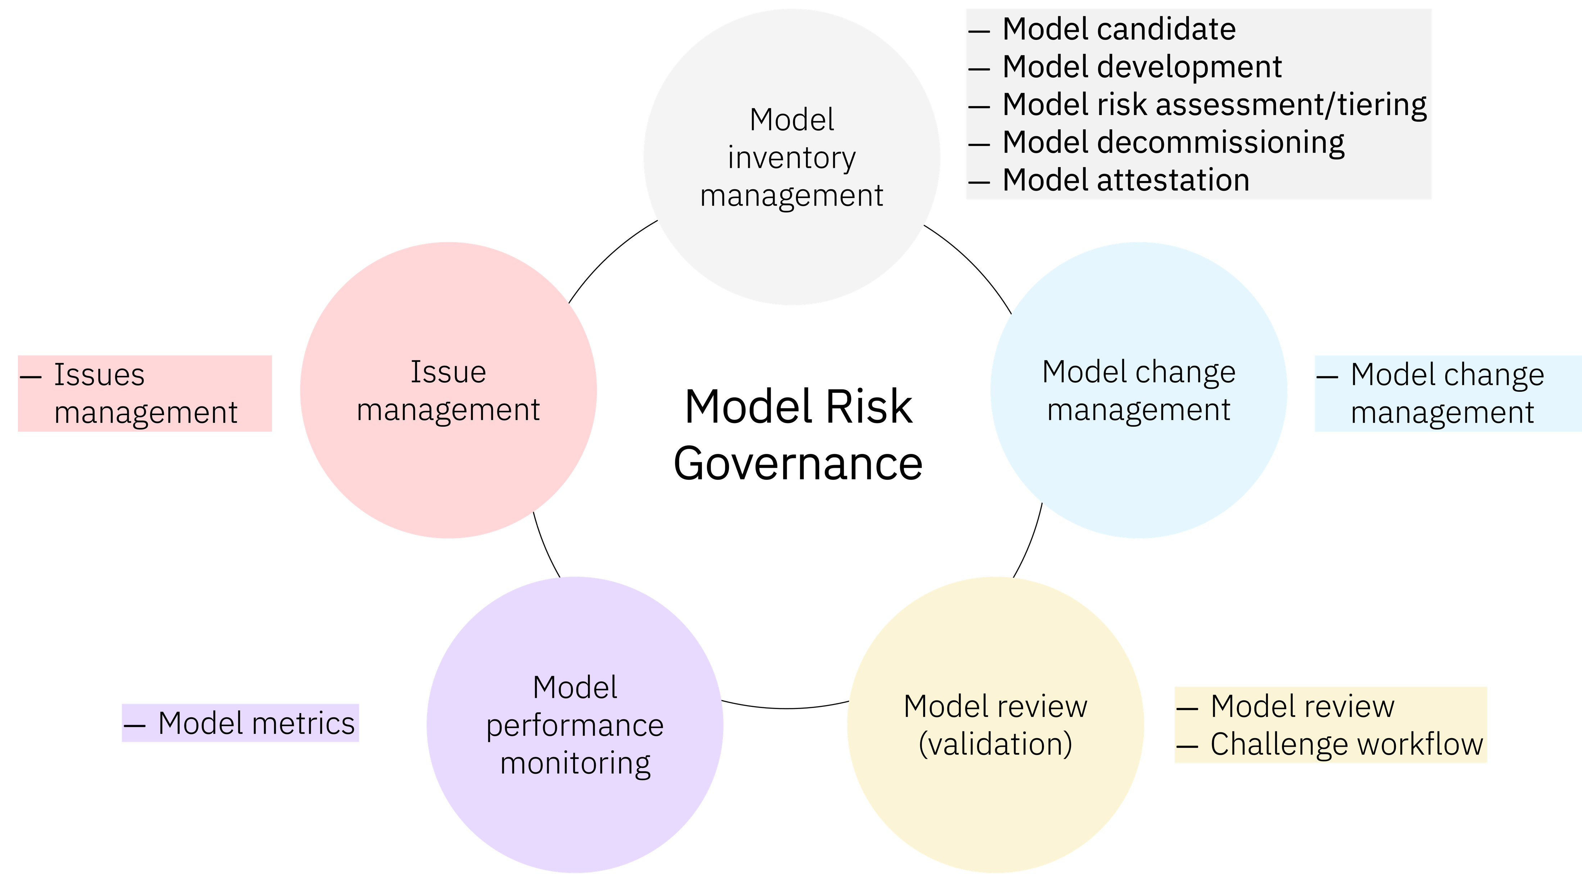
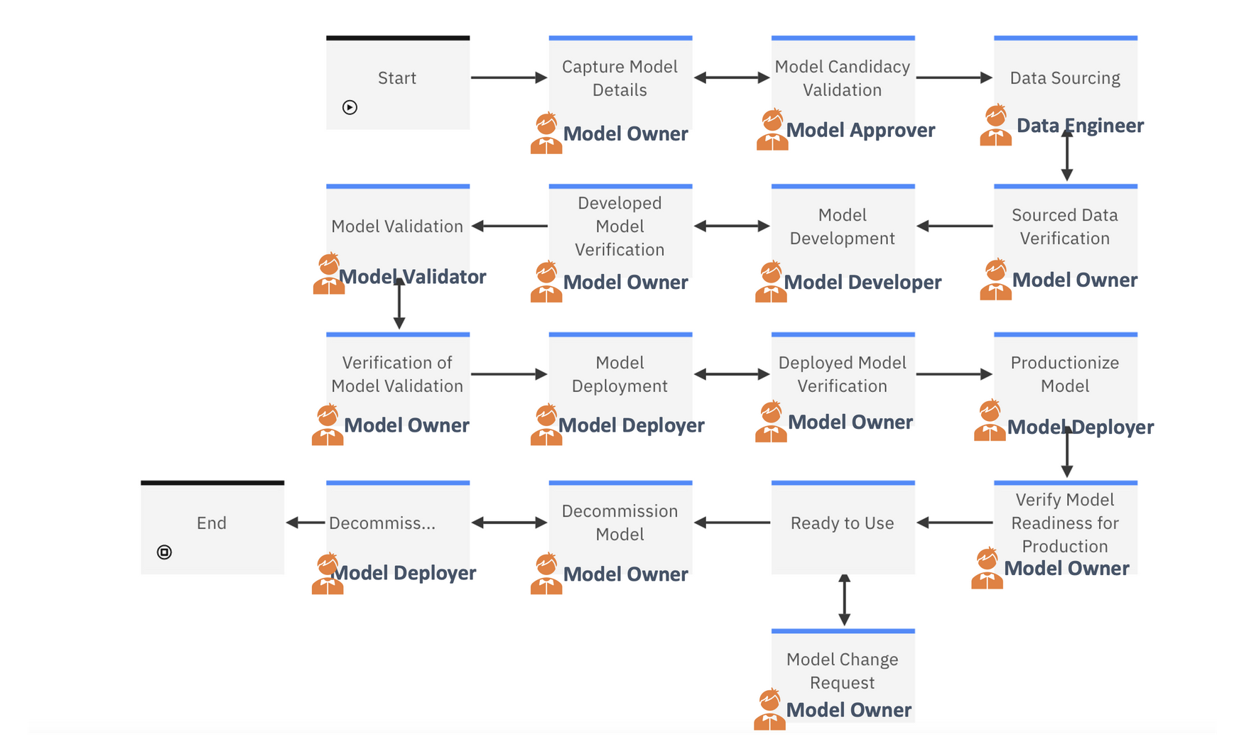
AI Governance Workflows with Policies - different approaches
Approach 1
Approach 2

Slide 32
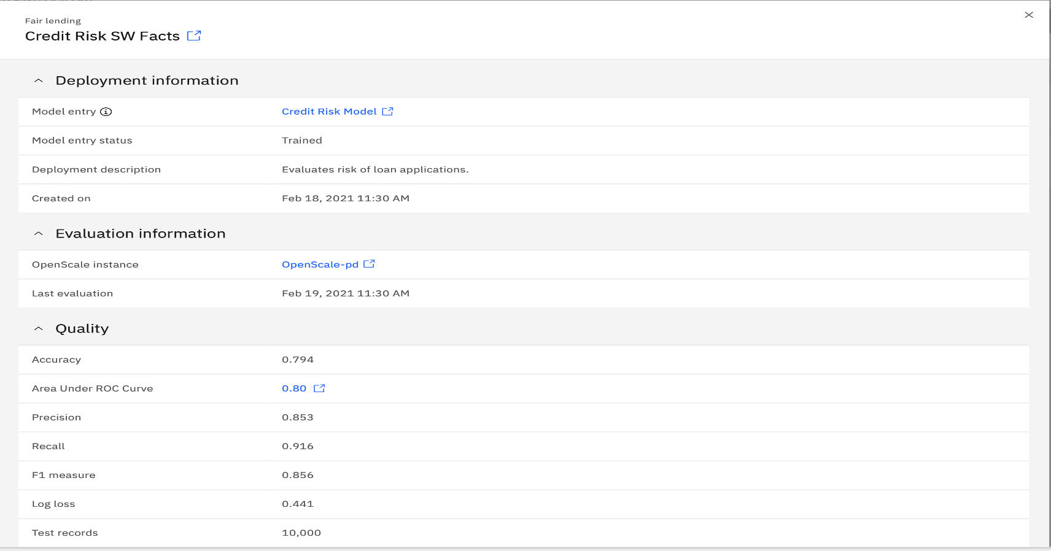
Model Facts
The 6 Pillars of a Healthy Machine Learning Model
https://ibm.biz/AI-HealthCheck
Feature and Prediction Drift

Slide 33
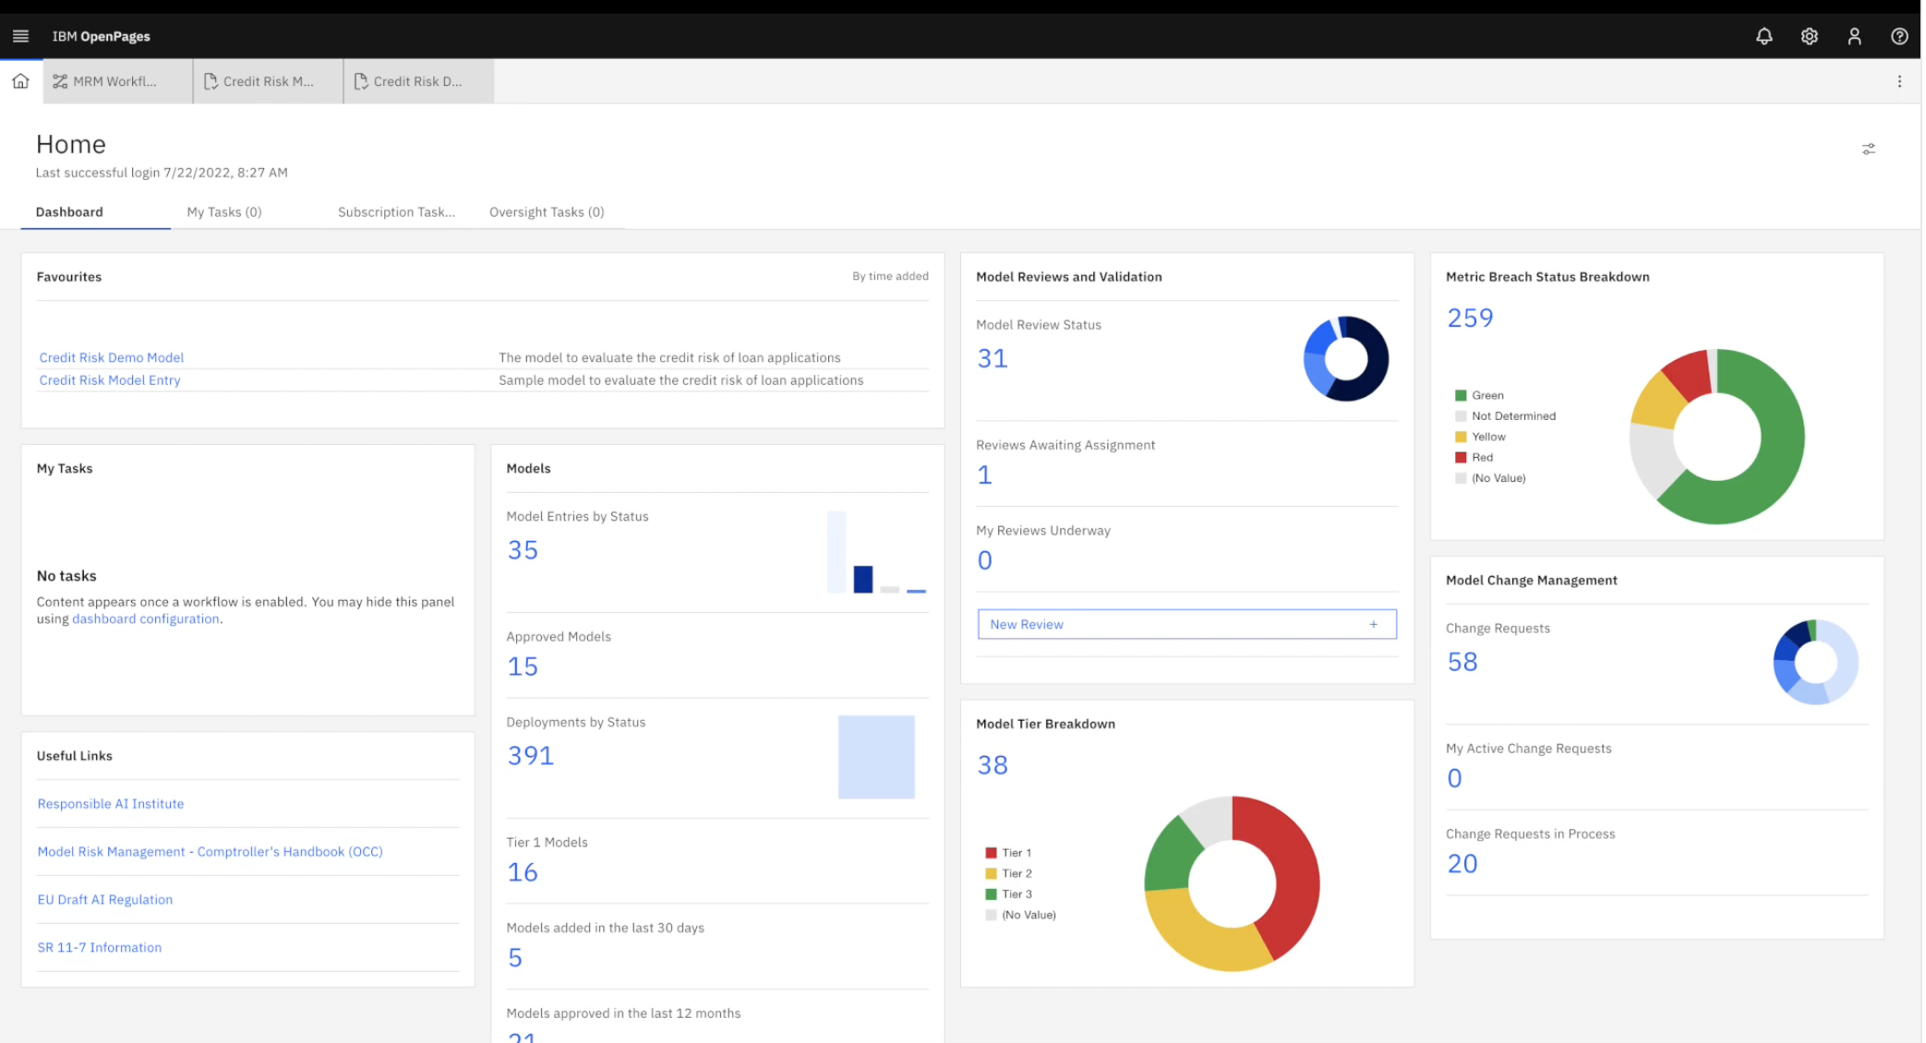
AI governance dashboard in CPD

Slide 34
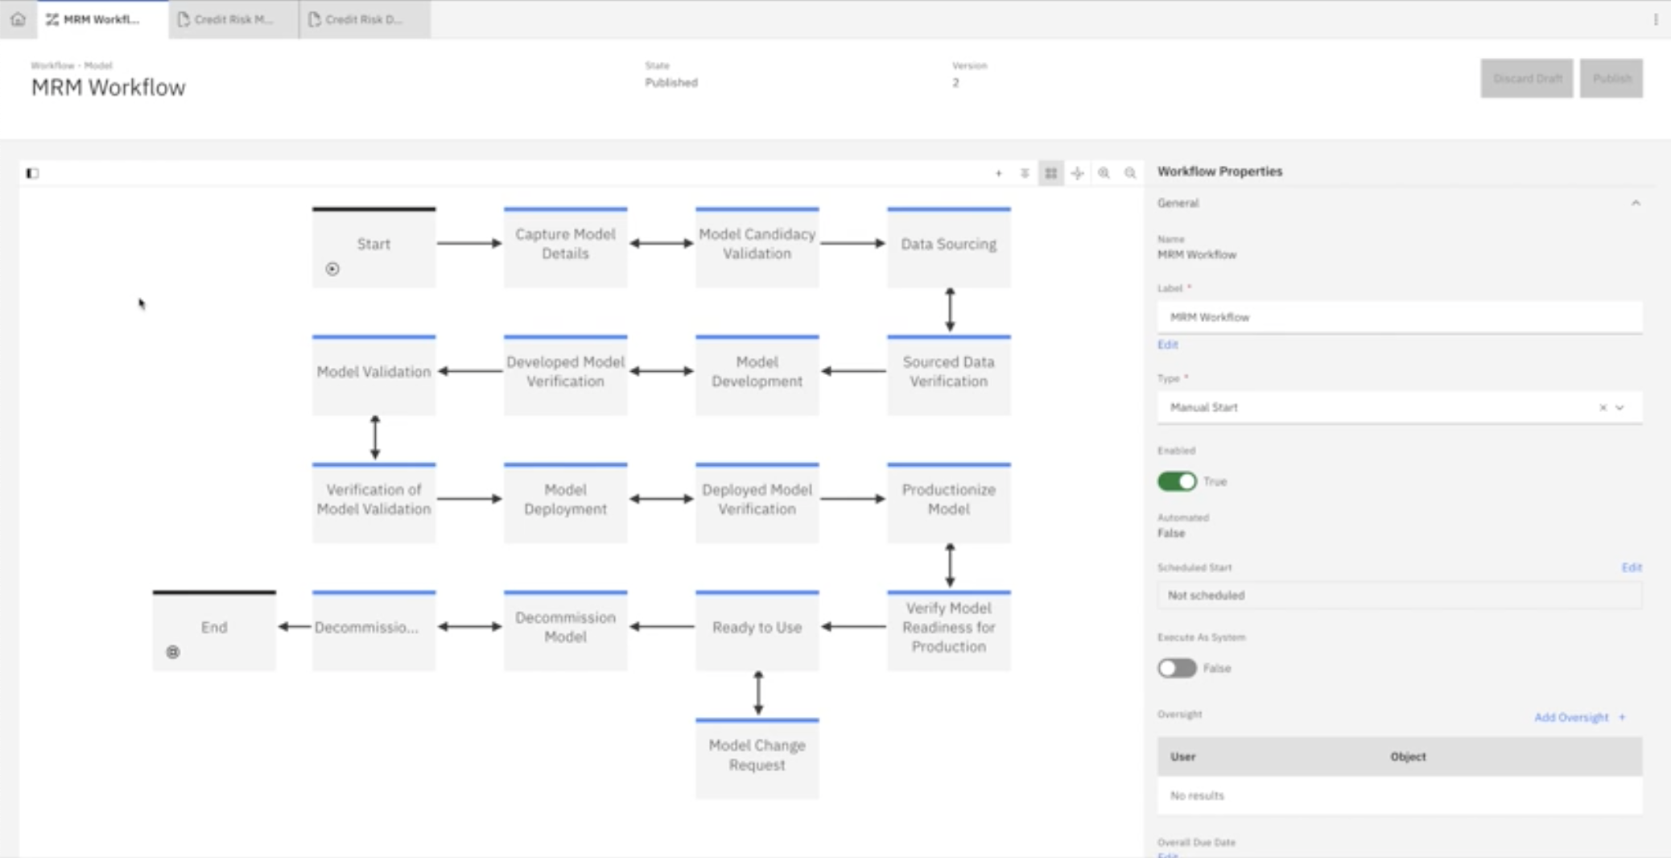
Governance Lifecycle for AI Models in CPD

Slide 35
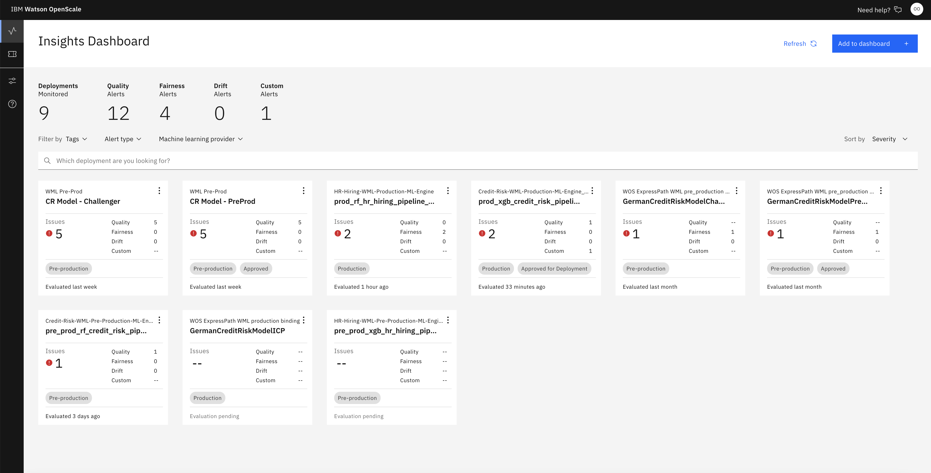
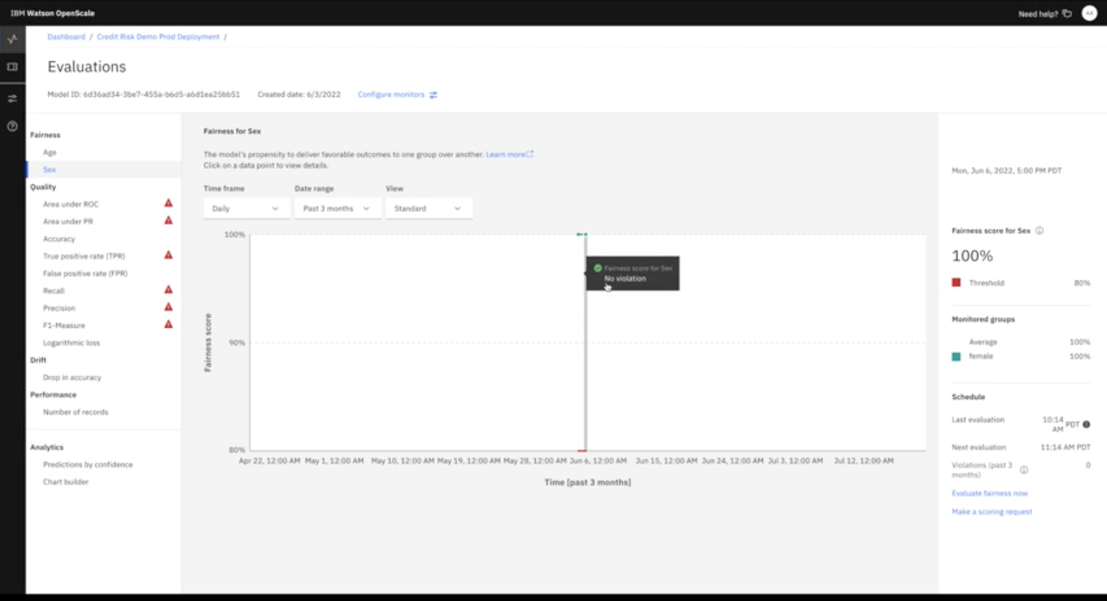
AI governance metrics in CPD
Fairness/bias
Data and model drift
Accuracy/Quality
Explainability
In house Metrics
3rd Party algorithm based Metrics
IBM Research
Adversarial robustness
Model Confidence
Others …

Slide 36
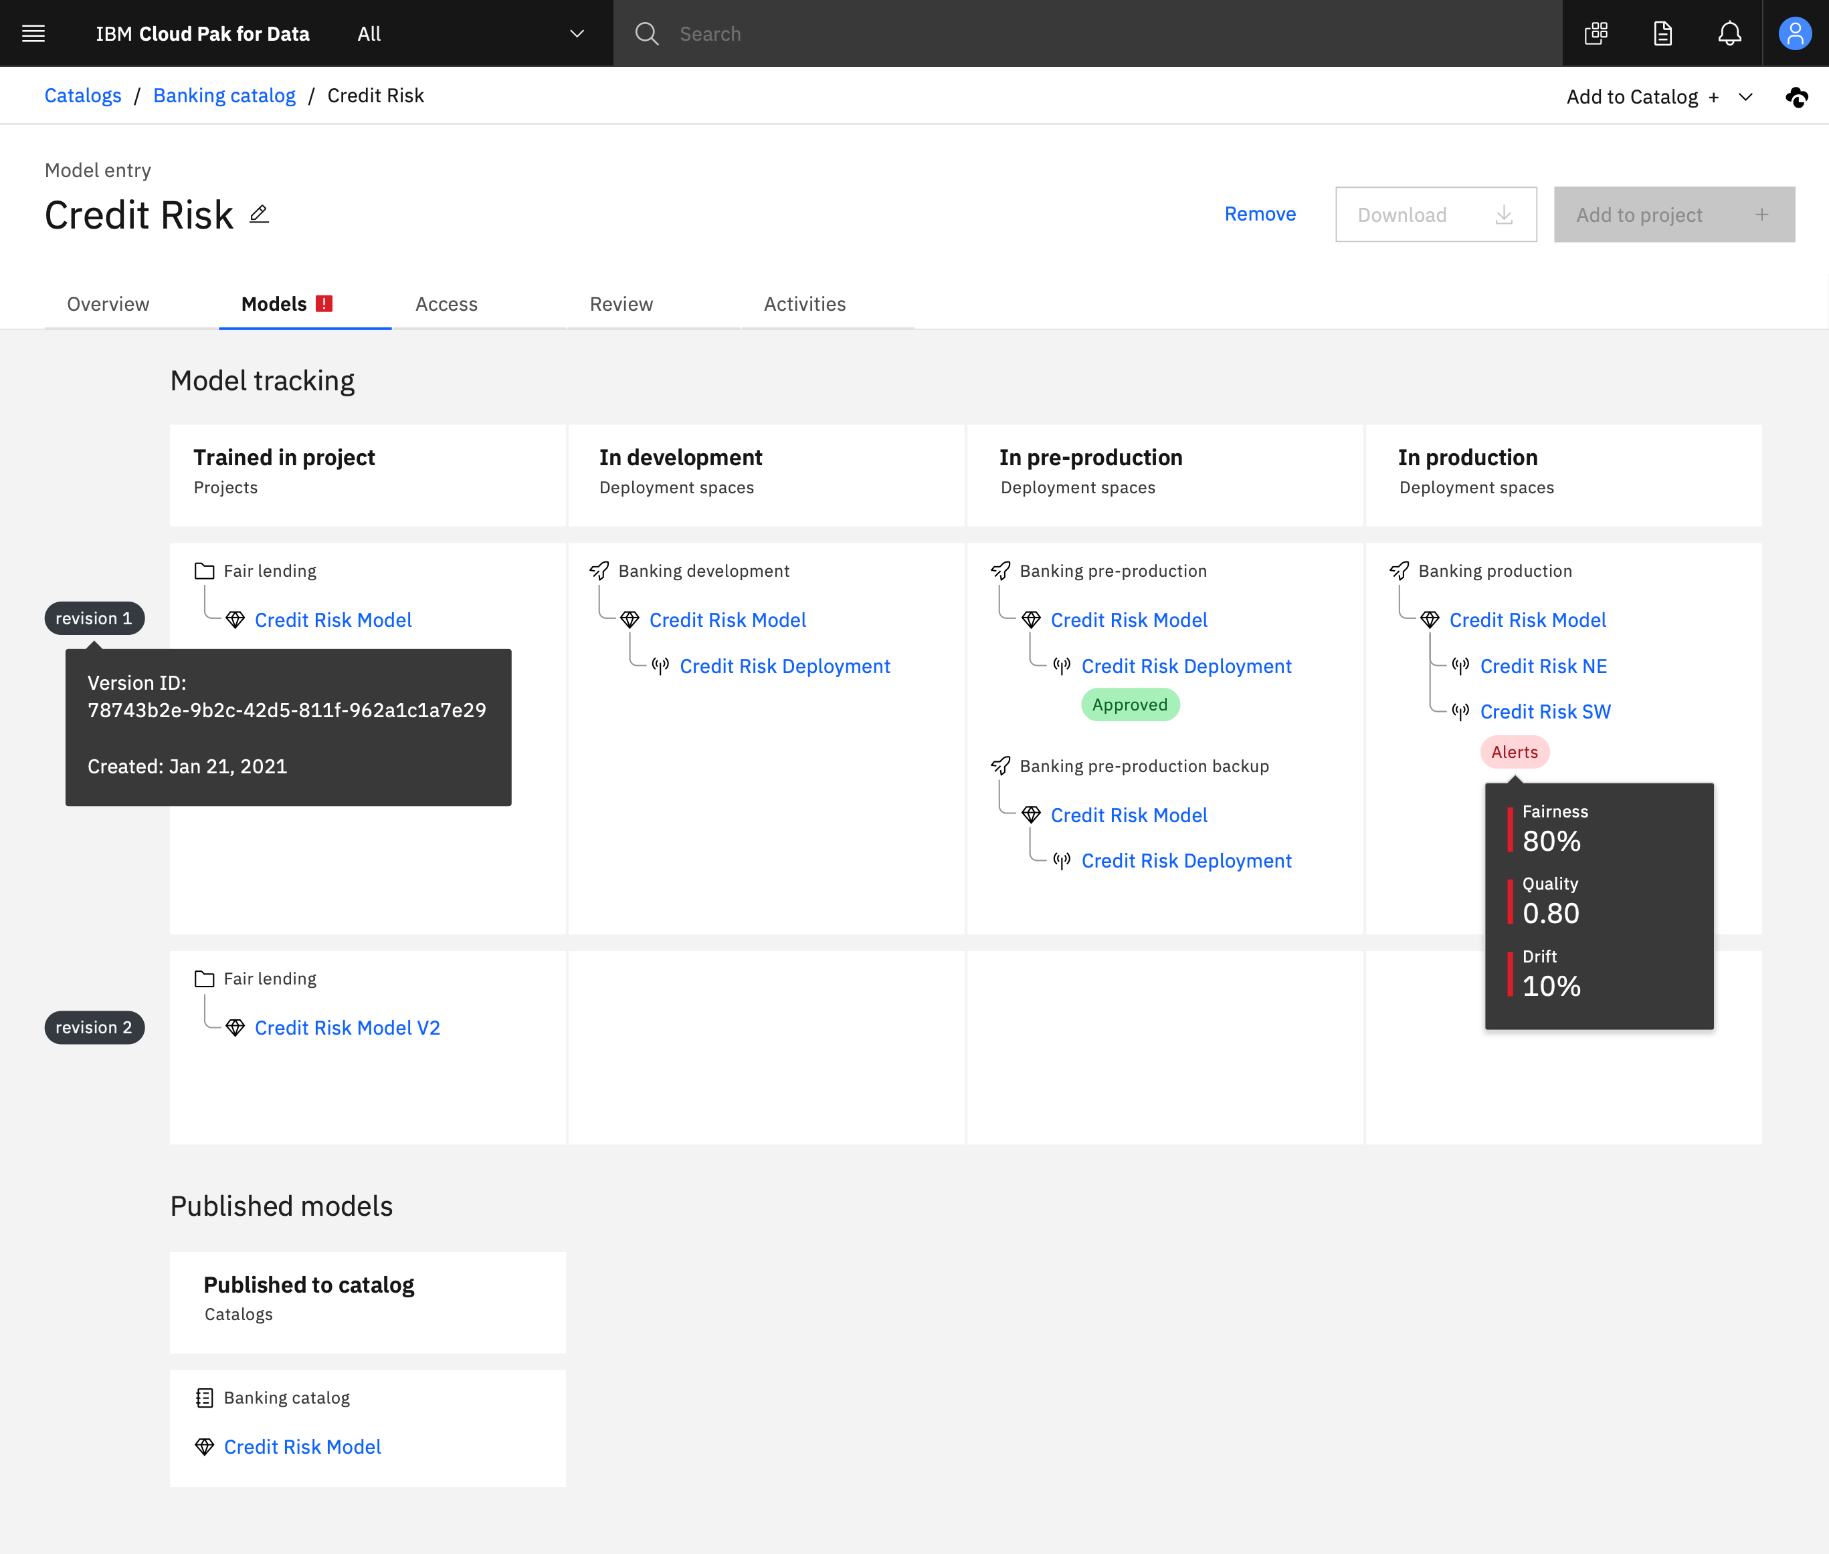
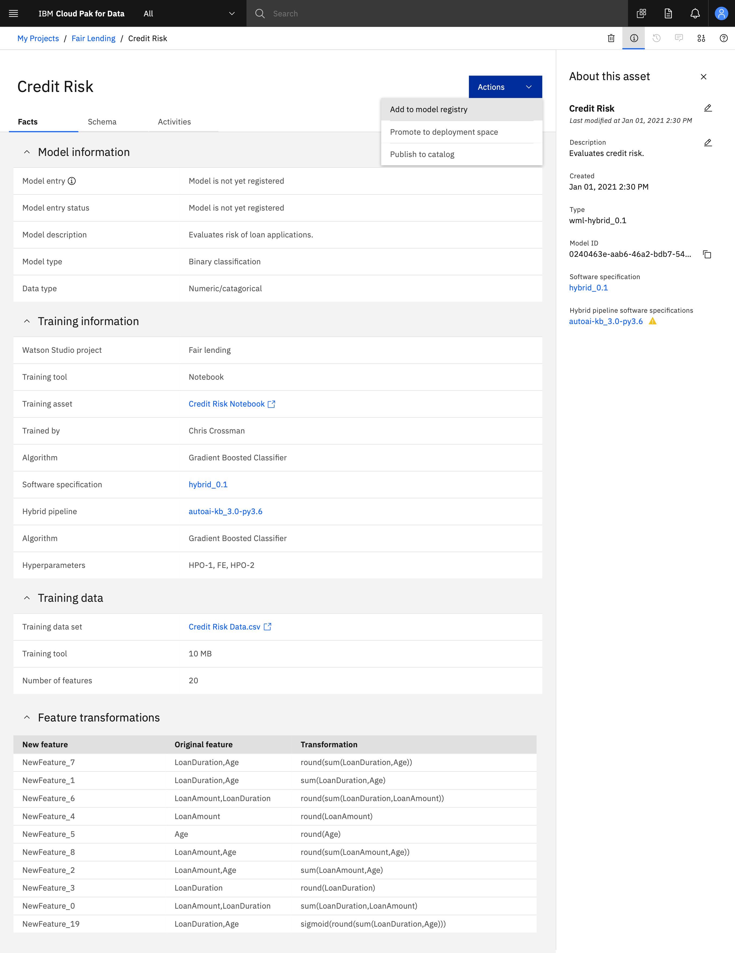
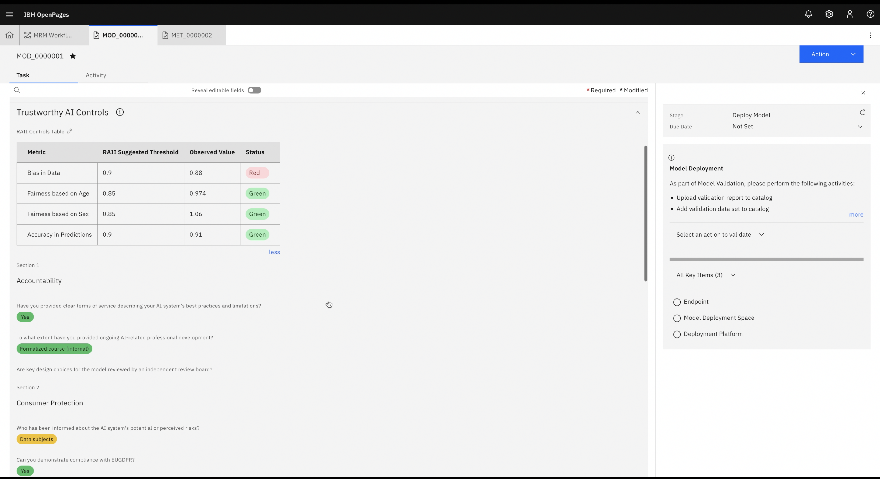
Factsheets of AI Models in CPD

